Slide 1
CS6795 - Culture
Kuhu Gupta
Jae Ro
James Howe

Slide 2
Exercise
Draw a circle

Slide 3
Exercise
Did you draw the circle clockwise or counter-clockwise?

Slide 4
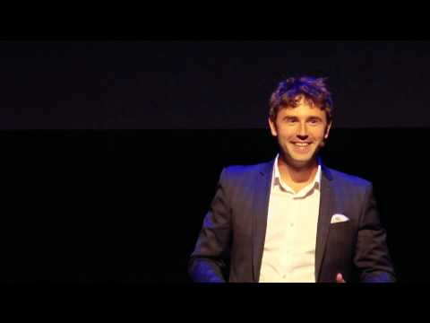
We’ll start with a video

Slide 5
Culture in Mind: Cognition, Culture, and the Problem of Meaning (Shore)

Slide 6
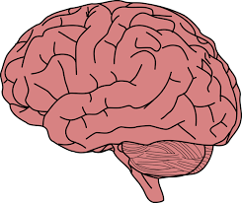
Summary
Cultural Diversity
Human brains at birth are only 25% of their adult size
Human brain development is greatly impacted by the surrounding natural and cultural environment
If you had never seen realistic 2D images prior to adulthood, you’d have to learn to understand them
People growing up around carpentry, with measurements, straight lines, and angles, are more easily fooled by optical illusions
Cultural Model: Patterns that governed conventional behaviors
Psychic Unity: Humans all share a common nervous system and the important cognitive entailment follow from this.

Slide 7
Example
Bradd Shore is an American.
In 1969, his arrival in Western Samoa as a Peace Corps was a serious encounter with a idea of culture.
He experienced an apparent gap between his own reactions and expectations and those of the people around him.
He went back home and came back to Samoa after 2 years of formal training in Anthropology.
This time, he had better understanding of cultural models.
He uses his cultural and cognitive resources to construct meanings out of anomalous experiences.
Notes:
https://global.oup.com/academic/product/culture-in-mind-9780195095975?cc=us&lang=en&#

Slide 8
Discussion
Are humans all basically the same psychologically, independent of cultures, or basically diverse because of cultural differences?
Can you define a human without his or her culture?

Slide 9
Understanding and Sharing Intentions: The Origins of Cultural Cognition (Tomasello)

Slide 10
“Fish are born expecting water, and humans are born expecting culture” – Michael Tomasello

Slide 11
Summary
Cultural Evolution
Humans are unique
Humans engage with each other in complex collaborative activities (culture)
Ratchet Effect
Shared symbolic artifacts, such as linguistic symbols and social institutions, facilitate their “transmission” across generations
What distinguishes humans from any other species?
Understanding intentions
Shared Intentionality
Phylogenetic
Ontogenetic
Systematic Cognitive assessments of both Apes & Children.

Slide 12
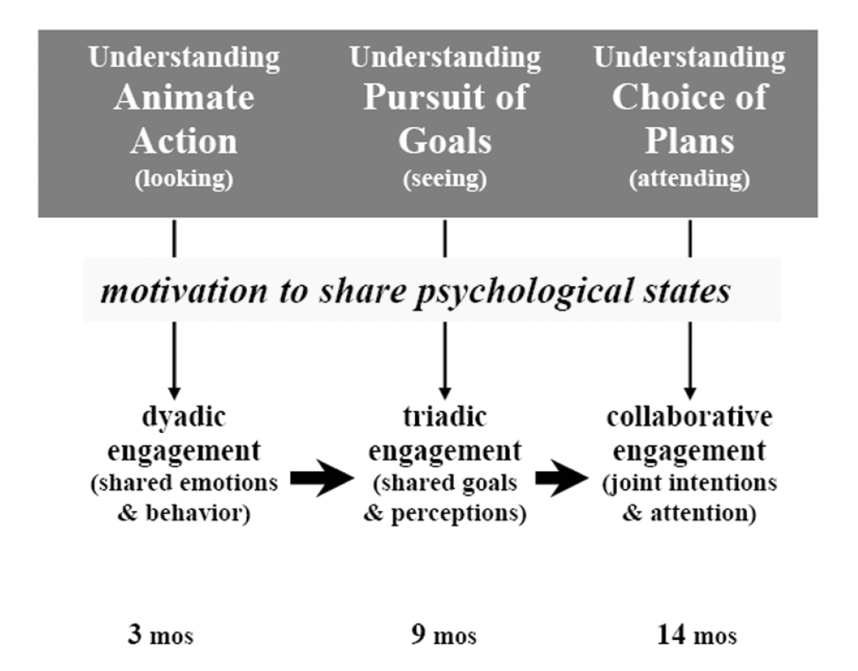
Intentional Action
The basic organization of an intentional action comprises of -
A reference value or goal toward which the system acts
The ability to act in order to change the environment
The ability to perceive the environment.

Slide 13
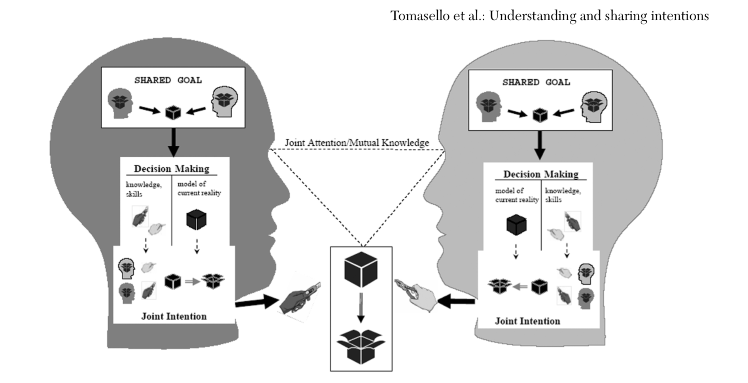
Shared Intentionality

Slide 14
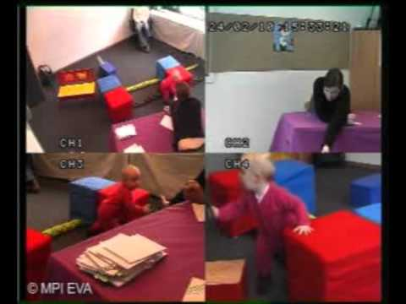

Slide 15
Discussion
Are humans the only species that can collaborate?
Are humans actually altruistic?

Slide 16
Critiques
Tomasello is missing a 3rd prerequisite
Communicating Relevant Information
Tomasello views the formation of human culture as a mere byproduct of an overarching species-specific drive to cooperate and share mental states with others
Language or Theory of Mind could explain uniqueness of human cognition instead of shared intentionality
Shared intentionality is not unique to humans
Uniquely human cognition and culture may not be reduced to a few basic abilities

Slide 17
Thank you!

